Slide 1
Chapter 17
DNA Sequencing and Cancer Genome
Jan 5, 2024

Slide 2
Outline of This Lecture
I, Sequencing Techniques
1st generation DNA sequencing
Sanger sequencing
Maxam–Gilbert sequencing
2nd generation DNA sequencing
Sequencing by Synthesis
– 454 Pyrosequencing
– Illumina Reversible Terminator Chemistry
– Ion Torrent Semiconductor Sequencing
Sequencing by ligation
– SOLiD – 2 base encoding
3rd generation DNA sequencing
Single-molecule real-time (SMRT) sequencing
Nanopore DNA sequencing
II, Cancer Genome

Slide 3
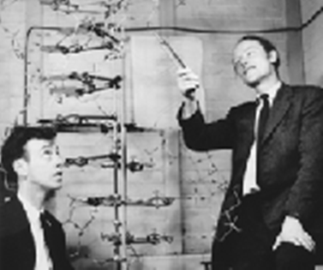
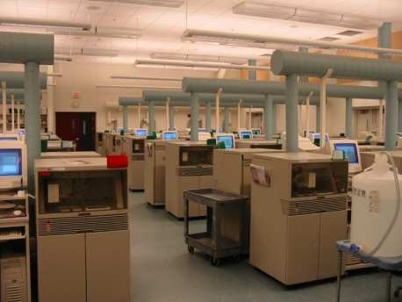

A quick history of sequencing
1869 – Discovery of DNA
1909 – Chemical characterisation 1953 – Structure of DNA solved 1977 – Sanger sequencing invented
– First genome sequenced – ФX174 (5 kb) 1986 – First automated sequencing machine 1990 – Human Genome Project started
1992 – First “sequencing factory” at TIGR

Slide 4

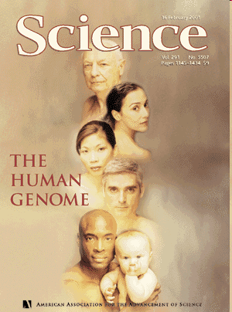
A quick history of sequencing
1995 – First bacterial genome – H. influenzae (1.8 Mb) 1998 – First animal genome – C. elegans (97 Mb) 2003 – Completion of Human Genome Project (3 Gb)
– 13 years, $2.7 bn
2005 – First “next-generation” sequencing instrument 2013– >10,000 genome sequences in NCBI database

Slide 5
A quick history of sequencing
• 1977
– First genome (ФX174)
– Sequencing by synthesis (Sanger)
– Sequencing by degradation (Maxam- Gilbert)

Slide 6
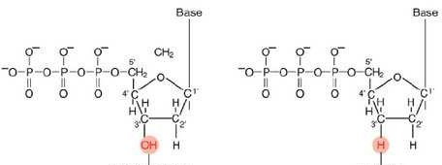
Sanger sequencing: chain termination method
• Uses DNA polymerase
• All four nucleotides, plus one dideoxynucleotide (ddNTP)
• Random termination at specific bases
• Separate by gel electrophoresis
deoxynucleotide
dideoxynucleotide

Slide 7
Sanger sequencing: chain termination method
A _{C}
G A
T* _{G} T
TCTGAT AGACTACGTACTTGACGAGTAC......
Incorporation of di-deoxynucleotides terminates DNA elongation
Individual reactions for each base

Slide 8
Sanger sequencing: chain termination method
TCTGATGCAT* TCTGATGCATGAACT* TCTGATGCATGAACTGCT* TCTGATGCATGAACTGCTCAT*
AGACTACGTACTTGACGAGTAC......
deoxynucleotide
dideoxynucleotide

Slide 9
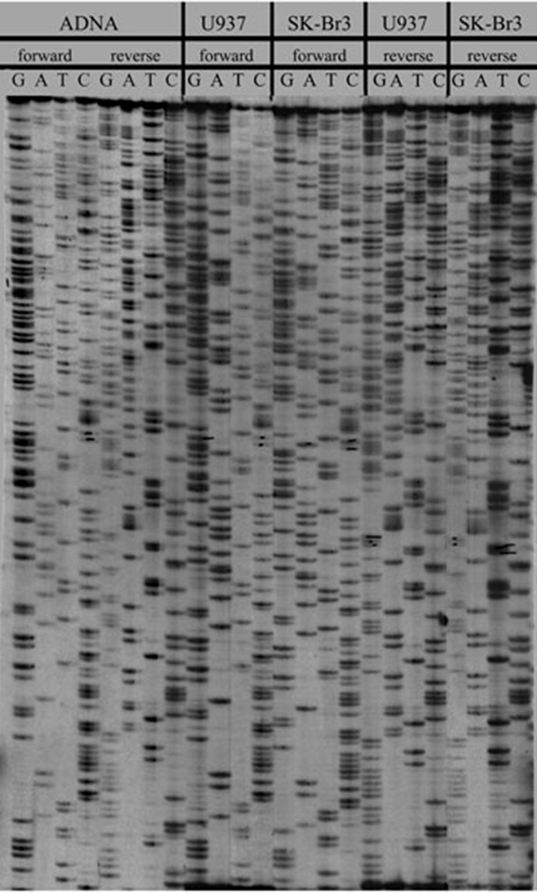
Sanger sequencing: chain termination method
Separation of fragments by gel electrophoresis

Slide 10
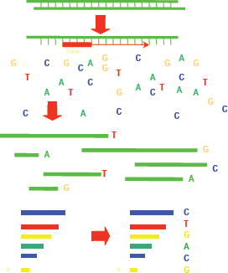
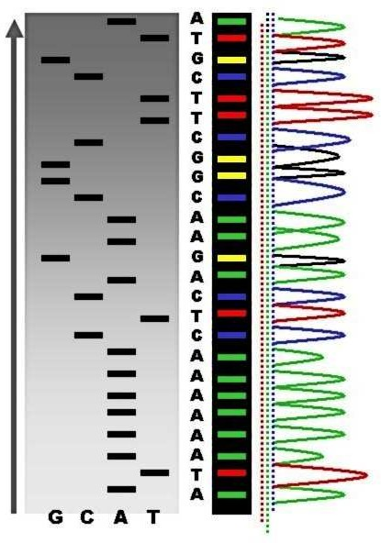
Sanger sequencing: dye-terminator sequencing
1986: 4 Reactions to 1 Lane fluorescently labelled ddNTPs
Sequencing Reaction Products
Progression of Sequencing Reaction

Slide 11
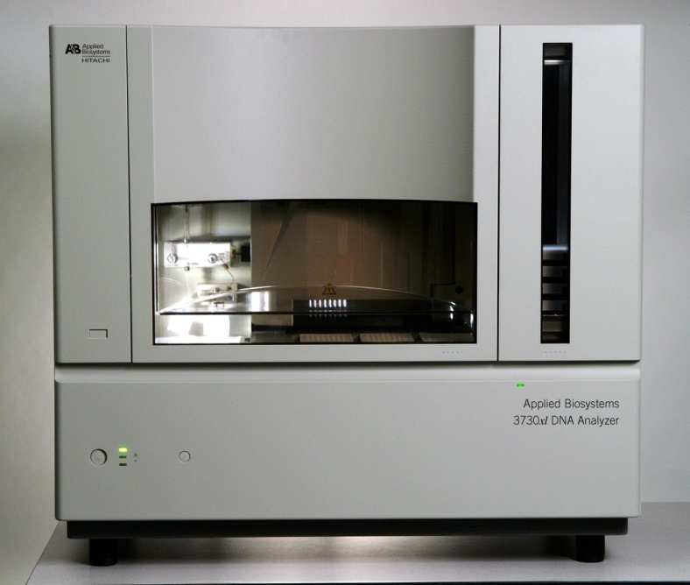
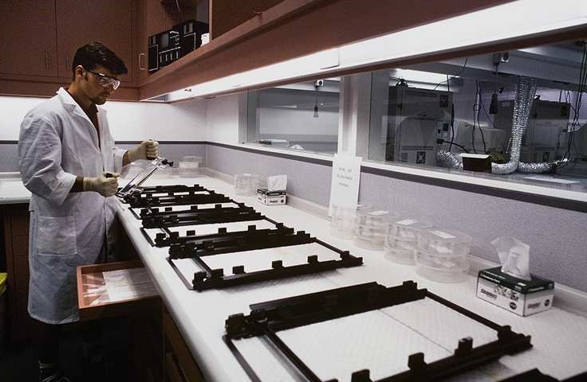

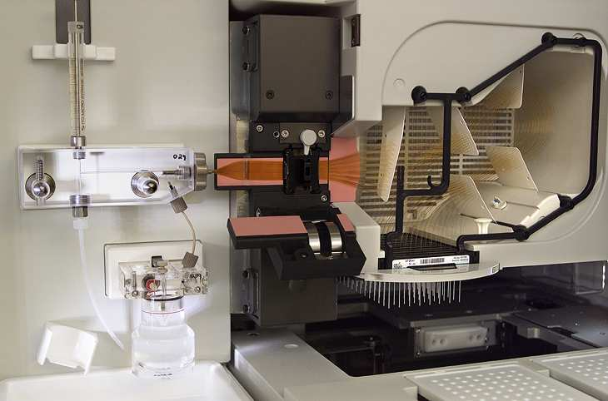
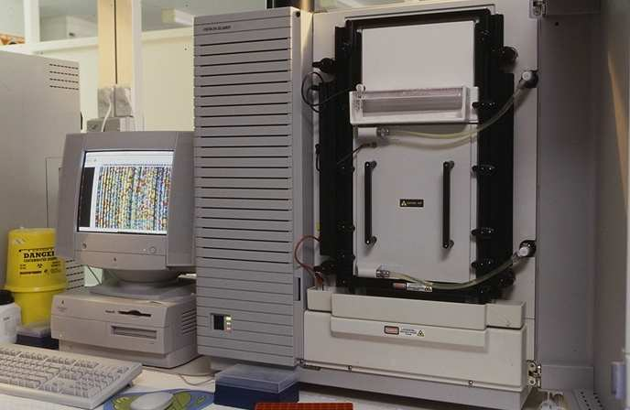
Sanger sequencing: dye-terminator sequencing
Automated DNA Sequencers
ABI 377 Plate Electrophoresis
ABI 3730 xl Capillary Electrophoresis

Slide 12
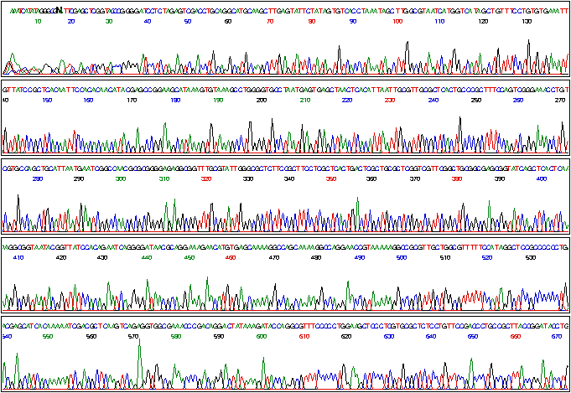
Sanger sequencing: dye-terminator sequencing

Slide 13
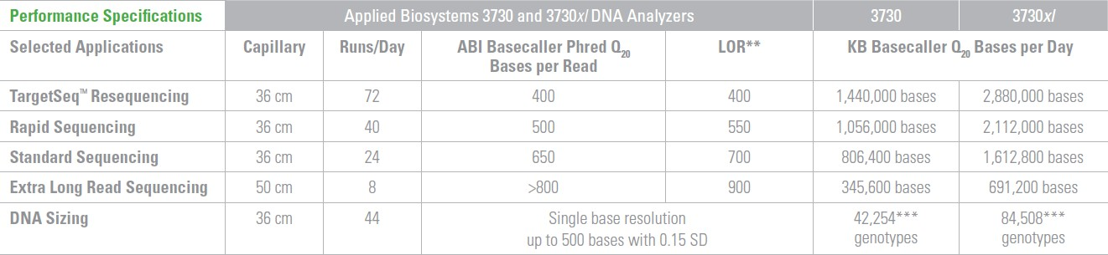
Sanger sequencing: dye-terminator sequencing
•Maximum read length
•Maximum yield/day
~900 base
< 2.1 million bases (rapid mode, 500 bp reads)
< 0.1% of the human genome
> 1000 days of sequencing for a 1 fold coverage ...

Slide 14
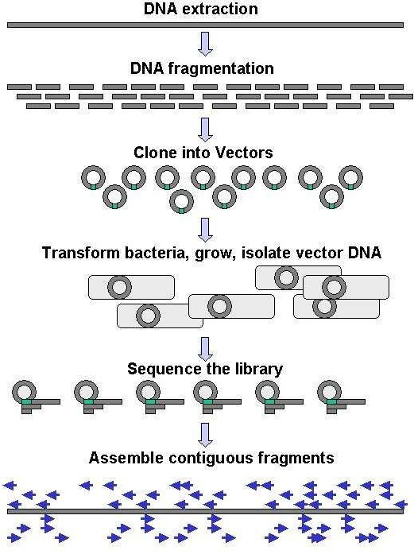
Sanger sequencing: shotgun library preparation

Slide 15
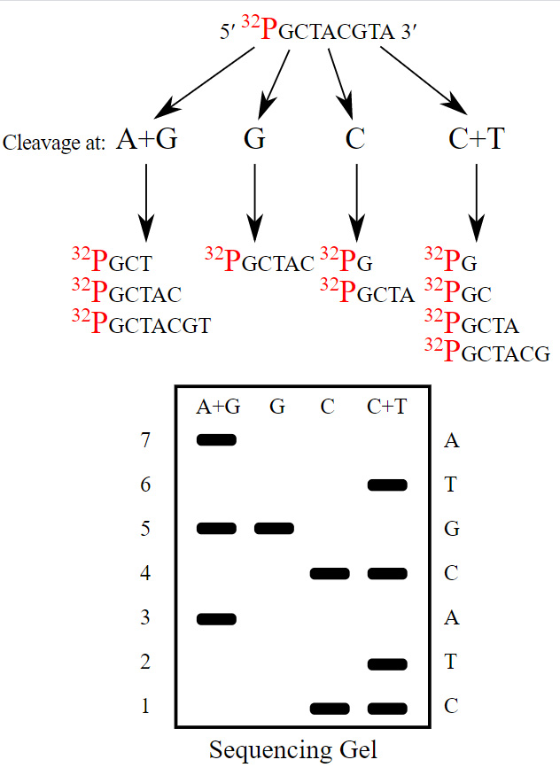
Maxam–Gilbert sequencing
Although Maxam and Gilbert published their chemical sequencing method two years after Frederick Sanger and Alan Coulson published their work on plus-minus sequencing,^{[2][3]} Maxam–Gilbert sequencing rapidly became more popular, since purified DNA could be used directly, while the initial Sanger method required that each read start be cloned for production of single-stranded DNA. However, with the improvement of the chain-termination method (see below), Maxam–Gilbert sequencing has fallen out of favour due to its technical complexity prohibiting its use in standard molecular biology kits, extensive use of hazardous chemicals, and difficulties with scale-up.

Slide 16
Human Genome Project
• Launched in 1989 –expected to take 15 years
– Competing Celera project launched in 1998
• Genome estimated to be 92% complete
_{– 1}st
Draft released in 2000
– “Complete” genome released in 2003
– Sequence of last chromosome published in 2006
• Cost: ~$3 billion
– Celera ~$300 million

Slide 17

Human Genome Project

Slide 18
2nd GENERATION SEQUENCING

Slide 19
Next-gen/2nd generation sequencing technologies
• Four main technologies
• All massively parallel sequencing
– Sequencing by synthesis
– Sequencing by ligation
• Mostly produce short reads- from <400bp
• Read numbers vary from ~ 1 million to ~ 1 billion per run

Slide 20
2nd generation sequencing technologies
• With massively parallel sequencing new methods for sequencing template preparation is required
• Current NGS platforms utilize clonal amplification on solid supports via two main methods:
– emulsion PCR (emPCR)
– bridge amplification (DNA cluster generation)

Slide 21
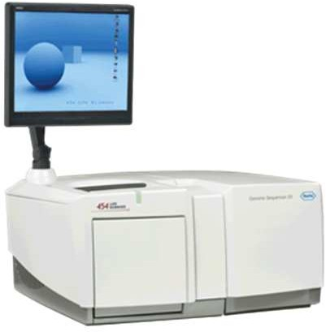
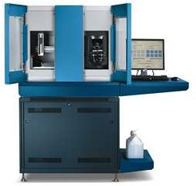
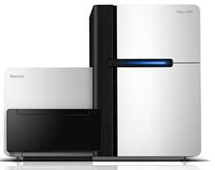
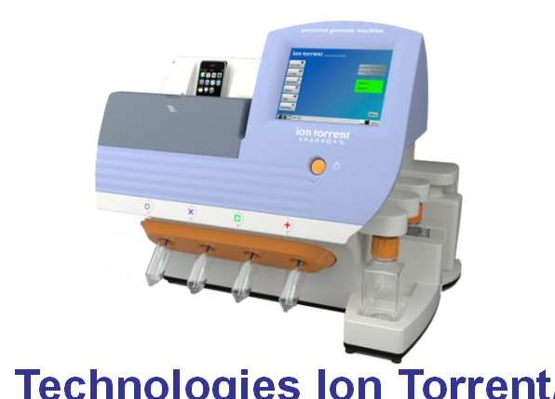
Next-gen sequencing technologies
Roche GS-FLX
Life Technologies SOLiD
Illumina HiSeq
Life Technologies Ion Torrent/Proton

Slide 22

Roche GS-FLX or 454 Life Sciences
454 Life Sciences was a biotechnology company based in Branford, Connecticut that specialized in high-throughput DNA sequencing. It was acquired by Roche in 2007 and shut down by Roche in 2013 when its technology became noncompetitive, although production continued until mid-2016

Slide 23
Roche GS-FLX or 454 Life Sciences
454 released the GS20 sequencing machine in 2005, the first next-generation DNA sequencer on the market. In 2008, 454 Sequencing launched the GS FLX Titanium series reagents for use on the Genome Sequencer FLX instrument, with the ability to sequence 400-600 million base pairs per run with 400-500 base pair read lengths. In late 2009, 454 Life Sciences introduced the GS Junior System, a bench top version of the Genome Sequencer FLX System.
454 Sequencing used a large-scale parallel pyrosequencing system capable of sequencing roughly 400-600 megabases of DNA per 10-hour run on the Genome Sequencer FLX with GS FLX Titanium series reagents.

Slide 24
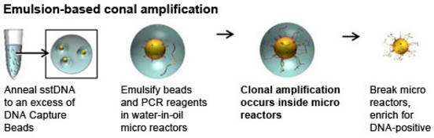
Emulsion PCR is a method of clonal amplification which allows for millions of unique PCRs to be performed at once through the generation of micro-reactors.
Emulsion PCR (emPCR)
Emulsion：乳液

Slide 25
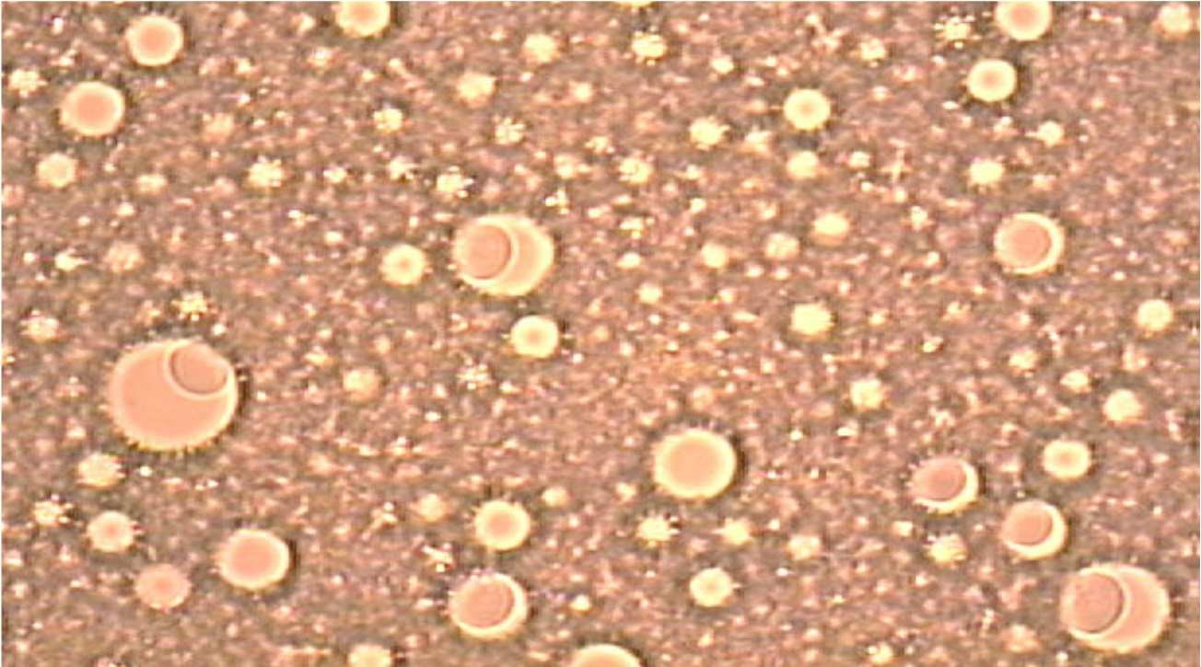
Emulsion PCR (emPCR)
The Water-in-Oil-Emulsion

Slide 26
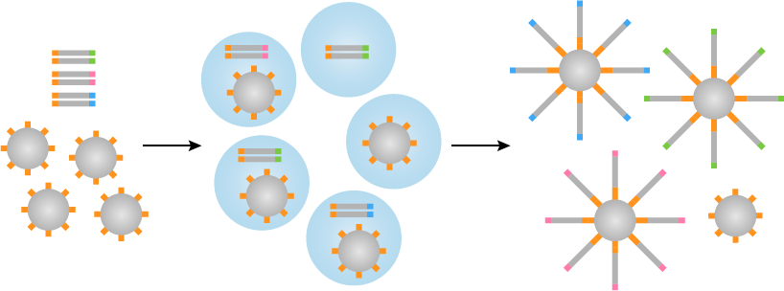
Emulsion PCR (emPCR)
This technique has been criticised for its time consuming nature, since it requires many steps (forming and breaking the emulsion, PCR amplification, enrichment etc) despite its extensive use in many of the NGS platforms. It is also relatively inefficient since only around two thirds of the emulsion micro reactors will actually contain one bead. Therefore an extra step is required to separate empty systems leading to more potential inaccuracies.

Slide 27
Pyrosequencing（焦磷酸测序技术）
The principle of Pyrosequencing was first described in 1993 by Bertil Pettersson, Mathias Uhlen and Pål Nyren
Pyrosequencing, developed by 454 Life Sciences, was one of the early successes of Next-generation sequencing; indeed, 454 Life Sciences produced the first commercially available Next-generation sequencer. However, the method was eclipsed by other technologies and, in 2013, new owners Roche announced the closure of 454 Life Sciences and the discontinuation of the 454 pyrosequencing platform.

Slide 28
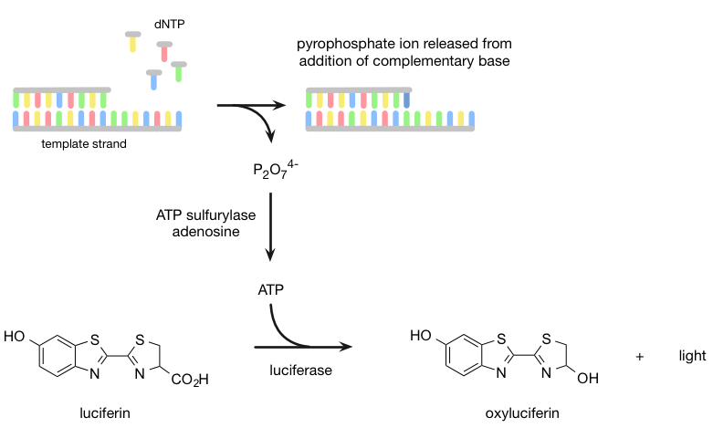
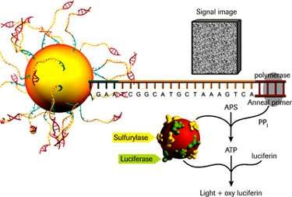
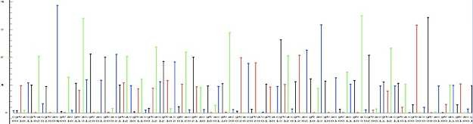
Pyrosequencing（焦磷酸测序技术）
sequencing by synthesis

Slide 29
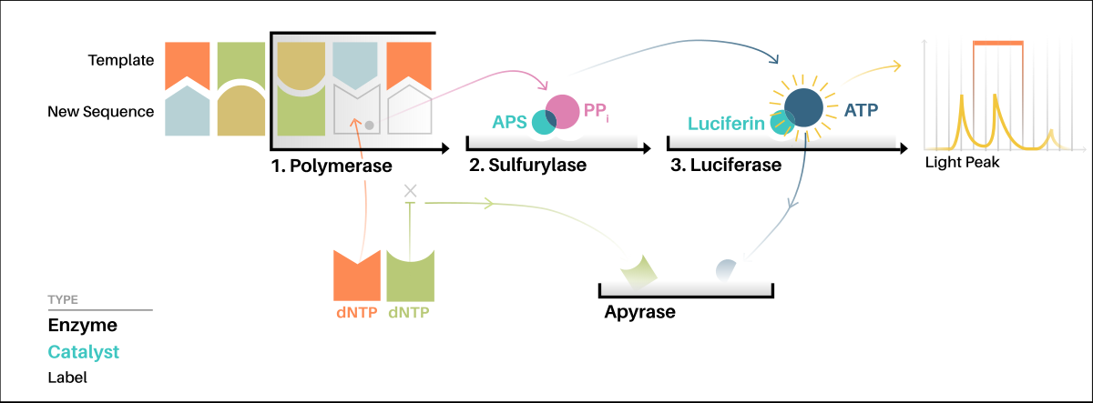
Pyrosequencing（焦磷酸测序技术）

Slide 30
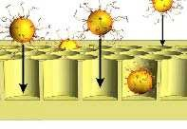
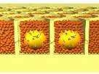
Massively Parallel Sequencing

Slide 31

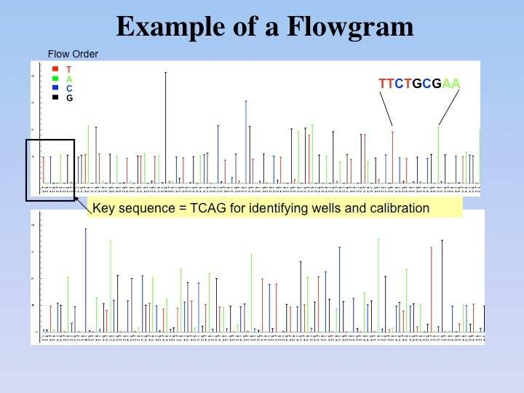

454: Data Processing
T Base Flow
A Base Flow
C Base Flow
G Base Flow
Raw Image Files
Image Processing
Base- calling
Quality Filtering
SFF File

Slide 32
454 Platform Updates
GS20
GS-FLX
GS-FLX Titanium GS-FLX Titanium Plus
GS Junior
• 100bp reads, ~20Mbp / run
• 250bp reads ~100 Mbp / run (7.5 hrs)
• 400bp reads ~400 Mbp / run (10 hrs)
• 700 bp reads ~700 Mbp/run (18 hrs)
• 400 bp reads ~ 35Mbp/run (10 hrs)

Slide 33
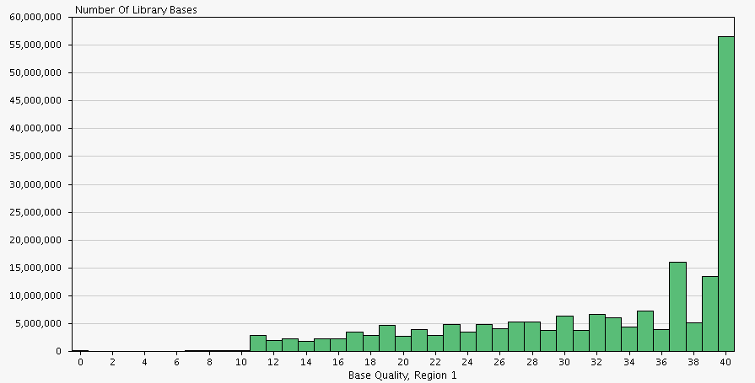
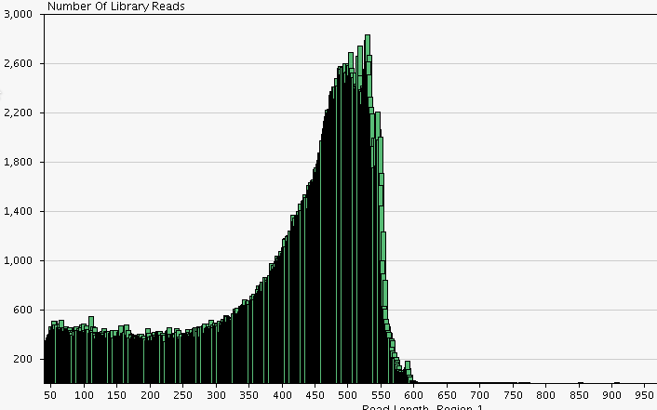
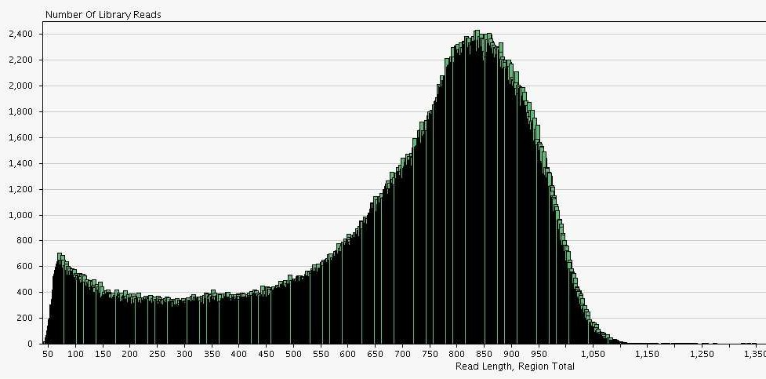
454 Sequencing Output
• *.sff (standard flowgram format)
• *.fna (fasta)
• *.qual (Phred quality scores)
~500 bp
~800 bp

Slide 34
Illumina HiSeq
Bridge PCR
Reversible terminator sequencing

Slide 35
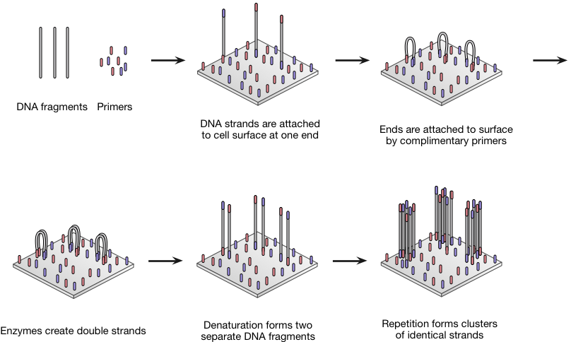
Bridge PCR
目的：原位扩增

Slide 36
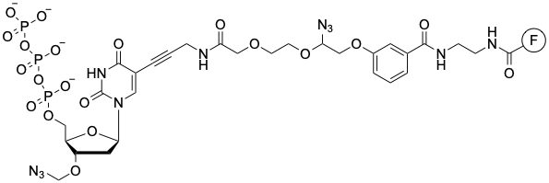
Reversible terminator sequencing (Illumina)
3′-O-blocked reversible terminators

Slide 37
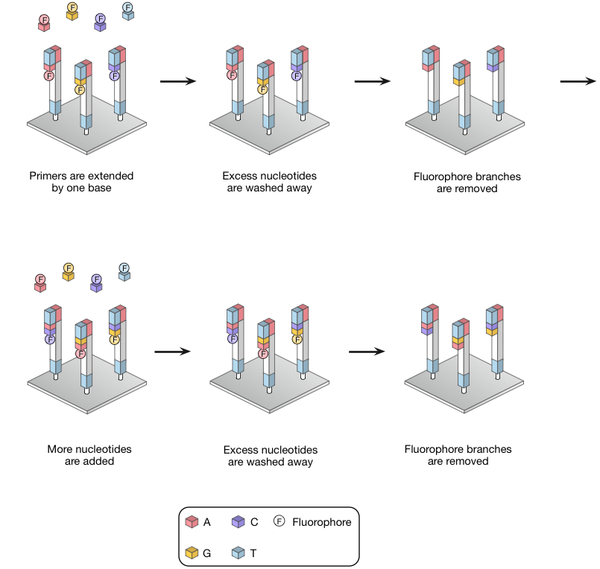
Reversible terminator sequencing (Illumina)

Slide 38
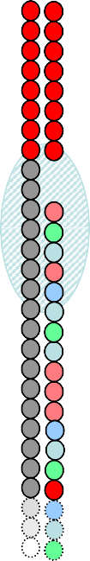
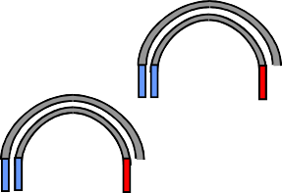

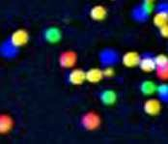
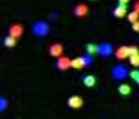
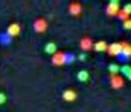
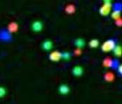
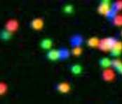
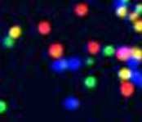
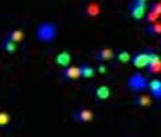
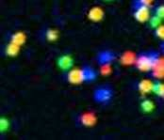
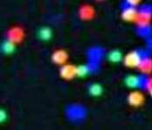
Illumina Sequencing Technology
Robust Reversible Terminator Chemistry Foundation
3’ 5’
DNA (0.1-1.0 ug)
A G
T G C T A C G A
T A C C C G A
T C G A T
C
A
T
C
G
T
A
C
G
Sample preparation
T
Cluster growth
5’
Sequencing
1
2
3
4
5
6
7
8
9
T G C T A C G A T …
Base calling
Image acquisition

Slide 39
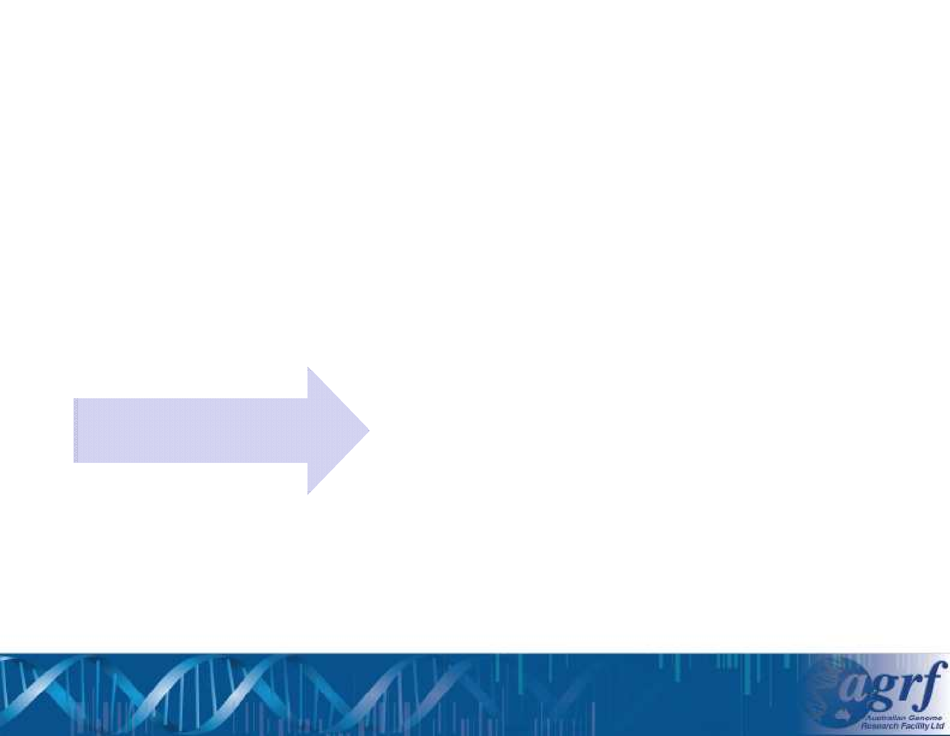
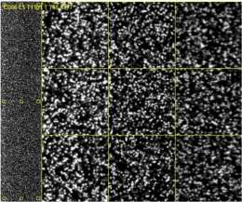
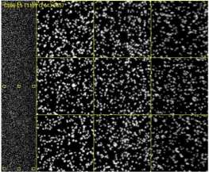
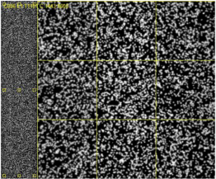


Illumina: Data Processing
Nucleotide Flows
Raw Images
Image Processing
Base- calling
Quality Filtering
.bcl

Slide 40
Platform Updates
Solexa 1G
Illumina GA Illumina GAII
Illumina GAIIx Illumina HiSeq 2000 Illumina HiSeq, v3 SBS
Illumina HiSeq 2500 (Rapid) MiSeq
• 18bp reads, ~1Gbp / run
• 36bp reads ~3Gbp / run
• 75bp paired ends ~10Gbp / run (8 days)
• 75bp paired end reads ~40Gbp / run (8 days)
• 100 bp paired end reads ~200 Gbp/ run (10 days)
• 100bp paired end reads ~600Gbp / run (12 days)
• 150 bp paired end reads ~ 180 Gbp/ run (2 days)
• 250 bp paired end reads ~8 Gb/run (2 days)
Maximum yield / day 50,Gbp
~16x the human genome

Slide 41

Illumina Sequencing Output
• *.fastq (sequence and corresponding quality score encoded with an ASCII character, phred- like quality score + 33)

Slide 42
Illumina fastq
1 2 3 4 5 6 7
8
@HWI-ST226:253:D14WFACXX:2:1101:2743:29814 1:N:0:ATCACG TGCGGAAGGATCATTGTGGAATTCTCGGGTGCCAAGGAACTCCAGTCACATCACGATCTCGTATGCCGTCTTCTGCTT GAAAAAAAAAAAAAAAAAATTA
+ B@CFFFFFHHFFHJIIGHIHIJJIJIIJJGDCHIIIJJJJJJJGJGIHHEH@)=F@EIGHHEHFFFFDCBBD:@CC@C
:<CDDDD50559<B########
1. unique instrument ID and run ID
2. Flow cell ID and lane
3. tile number within the flow cell lane
4. 'x'-coordinate of the cluster within the tile
5. 'y'-coordinate of the cluster within the tile
6. the member of a pair, /1 or /2 (paired-end or mate-pair reads only)
7. N if the read passes filter, Y if read fails filter otherwise
8. Index sequence

Slide 43
Applied Biosystems SOLiD
emPCR
Sequencing by Ligation

Slide 44

Sequencing by Ligation(SOLiD)

Slide 45

Sequencing by Ligation(SOLiD)

Slide 46
Limitations
This sequencing by ligation method has been reported to have problems sequencing palindromic sequences

Slide 47

Base Interrogations

Slide 48

2 Base encoding
AT

Slide 49


emPCR and Enrichment
3’ Modification allows covalent bonding to the slide surface

Slide 50



Platform Updates
SOLiD 3
• 50bp Paired reads ~50Gbp / run (12 days)
SOLiD 4
• 50bp Paired reads ~100Gbp / run (12 days)
5500xl
• 75bp Paired reads ~300Gbp / run (14 days)
Maximum yield / day 21,000,000,000bp 7x the human genome
3.5 hours of sequencing for a 1 fold coverage.....

Slide 51
SOLiD Colour Space Reads
• *.csfasta (colour space fasta)
• *.qual (Phred quality scores)
>853_17_1660_F3 T32111011201320102312......
AA | CC | GG | TT | 0
AC | CA | GT | TG | 1
AG | CT | GA | TC | 2
AT | CG | GC | TA | 3
Blue
Green
Yellow
Red

Slide 52

Applied Biosystems: Ion Torrent PGM

Slide 53


Ion Torrent
Ion torrent semiconductor sequencing
• Ion Semiconductor Sequencing
• Detection of hydrogen ions during the polymerization DNA
• Sequencing occurs in microwells with ion sensors
• No modified nucleotides
• No optics

Slide 54












Ion Torrent
dNTP
• DNA € Ions € Sequence
– Nucleotides flow sequentially over Ion semiconductor chip
– One sensor per well per sequencing reaction
– Direct detection of natural DNA extension
– Millions of sequencing reactions per chip
– Fast cycle time, real time detection
_{H}+
∆ pH
∆ Q
Sensing Layer
Sensor Plate
∆ V
Bulk Drain
Silicon Substrate
Source
To column receiver

Slide 55




Ion Torrent: System Updates
314 Chip
316 Chip
318 Chip P1 Chip
•100bp reads ~10 Mb/run (1.5 hrs)
•100 bp reads ~100 Mbp / run (2 hrs)
•200 bp reads ~200 Mbp/run (3 hrs)
•200 bp reads ~1 Gbp / run (4.5 hrs)
•100 bp reads ~8 Gbp/run

Slide 56


Ion Torrent Reads
• *.sff (standard flowgram format)
• *.fastq (sequence and corresponding quality score encoded with an ASCII character, phred- like quality score + 33)

Slide 57
Limitations
If homopolymer repeats of the same nucleotide (e.g. TTTTT) are present on the template strand (strand to be sequenced) then multiple introduced nucleotides are incorporated and more hydrogen ions are released in a single cycle. This results in a greater pH change and a proportionally greater electronic signal. This is a limitation of the system in that it is difficult to enumerate long repeats. This limitation is shared by other techniques that detect single nucleotide additions such as pyrosequencing.

Slide 58
Summary of NGS Platforms
• Clonal amplification of sequencing template
– emPCR (454, SOLiD and Ion Torrent)
– Bridge amplification (Illumina)
• Sequencing by Synthesis
– 454 Pyrosequencing
– Illumina Reversible Terminator Chemistry
– Ion Torrent Ion Semiconductor Sequencing
• Sequencing by ligation
– SOLiD – 2 base encoding
• Dramatic reduction in cost of sequencing
– GS-FLX provides > 100x decrease in costs compared to Sanger Sequencing
– HiSeq and SOLiD > 100x decrease in costs over GS-FLX

Slide 59
3rd generation sequencing
Single-molecule real-time (SMRT) sequencing
Nanopore DNA sequencing

Slide 60

Single-molecule real-time (SMRT) sequencing
参考视频链接
https://www.pacb.com/smrt-science/smrt-sequencing/
PAC BIO Sequel II System

Slide 61


Slide 62
Table 1.
Comparison of PacBio sequencing platforms to two current industry standards
Platform | Read length | Number reads | Error rate | Run rime
PacBio RSII (per SMRT cell) | Average 10–16 kb | ∼55 000 | 13–15% | 0.5–6 hours
PacBio Sequel (per SMRT cell) | Average 10–14 kb | ∼365 000 | 13–15% | 0.5–10 hours
Illumina HiSeq 4000 | 2 × 150 bp | 5 billion | ∼0.1% | <1–3.5 days
Illumina MiSeq | 2 × 300 bp | 25 million | ∼0.1% | 4–55 hours

Slide 63
Nanopore DNA sequencing
Nanopore sequencing took 25 years to fully materialise. It involved close collaboration between academia and industry. One of the first people to put forward the idea for nanopore sequencing was Professor David Deamer. In 1989 he sketched out a plan to drive a single-strand of DNA through a protein nanopore embedded into a thin membrane as part his work to synthesise RNA from scratch. Realising that the same approach might hold potential to improve DNA sequencing, Deamer and his team spent the next decade testing it out. In 1999 Deamer and his colleagues published the first paper using the term 'nanopore sequencing' and two years later produced an image capturing a hairpin of DNA passing through a nanopore in real time. Another foundation for nanopore sequencing was laid by the work of a team led by Professor Hagan Bayley who from the 1990s began to independently develop stochastic sensing, a technique that measures the change in an ionic current passing through a nanopore to determine the concentration and identity of a substance. By 2005 Bayley had made substantial progress with the method to sequence DNA and co-founded Oxford Nanopore to help push the technology further.

Slide 64

Nanopore DNA sequencing
参考视频链接
https://nanoporetech.com/applications/dna-nanopore-sequencing
Nanopore sequencing is a third generation approach used in the sequencing of biopolymers- specifically, polynucleotides in the form of DNA or RNA.

Slide 65


Nanopore DNA sequencing devices

Slide 66
SEQUENCING APPLICATIONS

Slide 67

RNA-seq (cDNA libraries)
• Shotgun cDNA library of
– Isolation of Poly(A) RNA or removal of rRNA
– (100 ng – 4 ug of total RNA)
– Chemical fragmentation of RNA
– Random primed cDNA Synthesis & 2nd strand Synthesis
– Follows standard “DNA” library protocol
• Stranded cDNA libraries
– 2nd Strand “Marking” incorporation of dUTP in place of dTTP during second strand synthesis.
– Selective enrichment for non-uracil containing 1st cDNA strand by
• Use of a polymerase that cannot amplify uracil containing templates
• Small RNA Sample Preparation
– RNA-adaptor ligation before cDNA synthesis
– Small RNA size selection via PAGE
• Library fragment ~145-160bp (insert 20-33 nucleotides)

Slide 68


RNA-seq applications
• Gene Expression
• Alternative Splicing & Allele Specific Expression
• Transcriptome Assembly

Slide 69




Targeted re-sequencing: hybrid capture
• Enrichment for specific targets via capture with oligonculeotide baits
– Exome Capture
• Capture 40-70 Mb of annotated exons and UTRs
– Custom Capture
• up to 50 Mb of target sequences

Slide 70

Epigenetic: Bisulfite sequencing

Slide 71

Paired-end sequencing
paired-end vs single-read sequencing

Slide 72
Cancer genomics: systematic genetics study of cancer
1978, Sanger sequencing
2005, 2nd generation sequencing
小样本测序 →小样本WES → TCGA → PCAWG

Slide 73
An Integrated Genomic Analysis of Human Glioblastoma Multiforme
Science 26 Sep 2008:Vol. 321, Issue 5897, pp. 1807-1812

Slide 74
Glioblastoma multiforme (GBM) is the most common and lethal type of brain cancer. To identify the genetic alterations in GBMs, we sequenced 20,661 protein coding genes, determined the presence of amplifications and deletions using high-density oligonucleotide arrays, and performed gene expression analyses using next-generation sequencing technologies in 22 human tumor samples. This comprehensive analysis led to the discovery of a variety of genes that were not known to be altered in GBMs. Most notably, we found recurrent mutations in the active site of isocitrate dehydrogenase 1 (IDH1) in 12% of GBM patients. Mutations in IDH1 occurred in a large fraction of young patients and in most patients with secondary GBMs and were associated with an increase in overall survival. These studies demonstrate the value of unbiased genomic analyses in the characterization of human brain cancer and identify a potentially useful genetic alteration for the classification and targeted therapy of GBMs

Slide 76
Overall survival according to IDH1 mutation status.

Slide 79
The Cancer Genome Atlas Pan-Cancer analysis project
Nature Genetics volume 45, pages1113–1120 (2013)

Slide 80

Figure 1: Integrated data set for comparing and contrasting multiple tumor types

Slide 81

Figure 2: Data coordination for the Pan-Cancer TCGA project

Slide 82
Mutational landscape and significance across 12 major cancer types
Nature volume 502, pages333–339 (2013)

Slide 83
The Cancer Genome Atlas (TCGA) has used the latest sequencing and analysis methods to identify somatic variants across thousands of tumours. Here we present data and analytical results for point mutations and small insertions/deletions from 3,281 tumours across 12 tumour types as part of the TCGA Pan-Cancer effort. We illustrate the distributions of mutation frequencies, types and contexts across tumour types, and establish their links to tissues of origin, environmental/carcinogen influences, and DNA repair defects. Using the integrated data sets, we identified 127 significantly mutated genes from well-known (for example, mitogen-activated protein kinase, phosphatidylinositol-3-OH kinase, Wnt/β-catenin and receptor tyrosine kinase signalling pathways, and cell cycle control) and emerging (for example, histone, histone modification, splicing, metabolism and proteolysis) cellular processes in cancer. The average number of mutations in these significantly mutated genes varies across tumour types; most tumours have two to six, indicating that the number of driver mutations required during oncogenesis is relatively small. Mutations in transcriptional factors/regulators show tissue specificity, whereas histone modifiers are often mutated across several cancer types. Clinical association analysis identifies genes having a significant effect on survival, and investigations of mutations with respect to clonal/subclonal architecture delineate their temporal orders during tumorigenesis. Taken together, these results lay the groundwork for developing new diagnostics and individualizing cancer treatment.

Slide 84
Figure 1: Mutation frequencies, spectra and contexts across 12 cancer types

Slide 85

Figure 2: The 127 SMGs from 20 cellular processes in cancer identified in 12 cancer types.

Slide 86

Figure 3: Distribution of mutations in 127 SMGs across Pan-Cancer cohort

Slide 87

Figure 4: Unsupervised clustering based on mutation status of SMGs

Slide 88

Figure 5: Driver initiation and progression mutations and tumour clonal architecture

Slide 89
Cancer genomics future trends and questions
1, Complex genome alterations (eg. structural alterations) in cancer;
2, Single cell genomics, time-serial genomics and cancer evolution;
3, Cancer noncoding drivers;
4, from cancer drivers to cancer precision therapy;
5, from DNA alterations to precision cancer immunotherapy;

